Slide 1
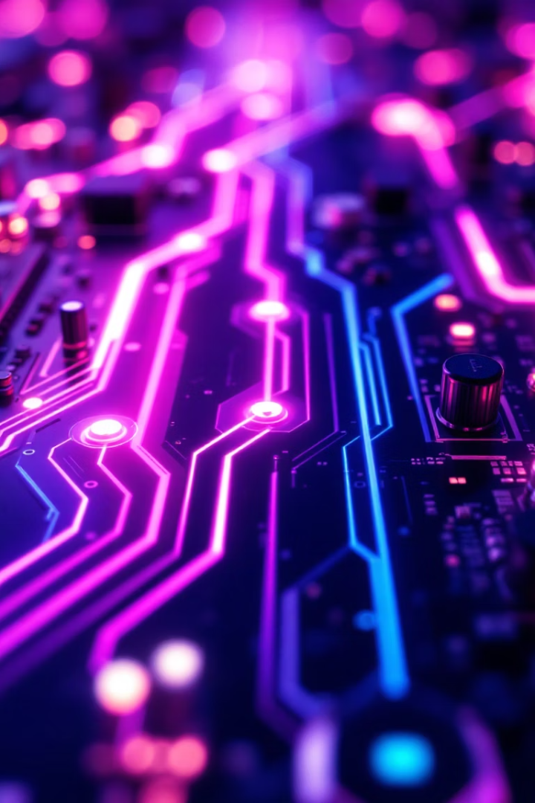

Advanced Image Enhancement: A Comprehensive Overview
Explore advanced image enhancement with histogram equalization and filters. Techniques include CLAHE, Adaptive HE, HSV Equalization, smoothing, and sharpening. Built in Python with OpenCV and scikit-image, optimized for research and practical use.
by Mohamed Amr

Slide 2
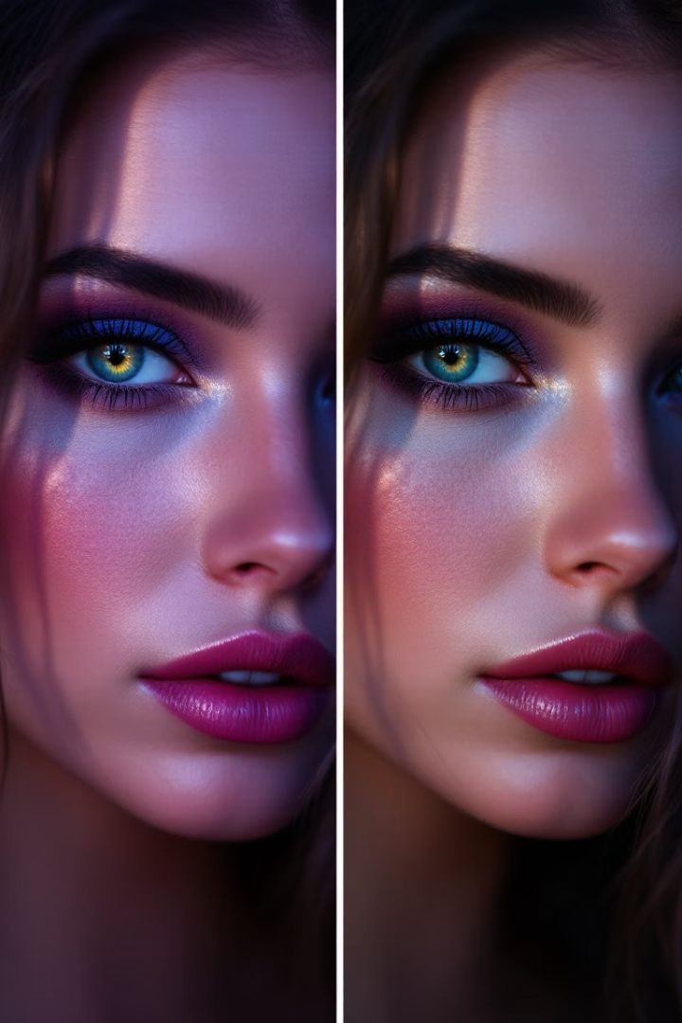
Introduction to Image Enhancement
Purpose
Improve visual perception and feature extraction in images.
Challenges
Avoid noise amplification and over-enhancement artifacts.
Histogram Equalization
Maps pixel intensities to achieve uniform brightness distribution.
Goal
Maximize contrast for clearer image details.

Slide 3
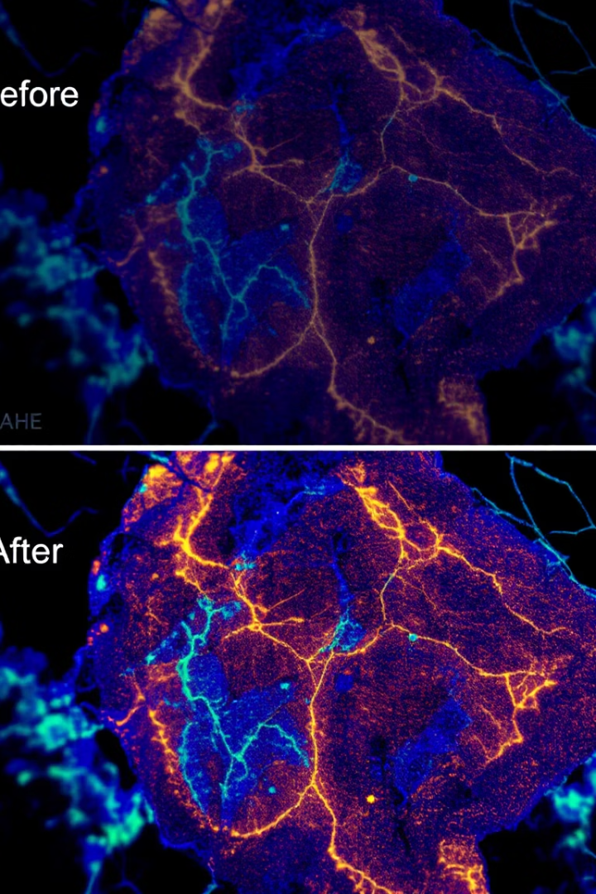
Contrast Limited Adaptive Histogram Equalization (CLAHE)
How it works
Divides image into tiles and equalizes each tile separately.
Contrast Limiting
Clips histogram to prevent noise amplification and artifacts.
Key Parameters
Tile size and clip limit control enhancement strength.
Use Case
Enhances low-contrast medical images by revealing hidden details.

Slide 4

Adaptive Histogram Equalization
Addressing HE shortcomings
Reduces over-enhancement and artifacts common in global Equalization.
Method
Applies equalization in sliding windows for localized contrast enhancement.
Benefits
Improves contrast in uneven lighting and complex scenes.
Outcome
Better image clarity with fewer artifacts.

Slide 5
HSV Equalization
Color Space
Technique
Applications
Example
Uses Hue, Saturation, and Value channels to separate brightness.
Equalizes the Value channel to increase brightness while preserving colors.
Ideal for color images needing brightness adjustment without hue changes.
Enhances satellite images with varying illumination effectively.

Slide 6

Filters for Image Enhancement
Smoothing Filters
Sharpening Filters
Reduce noise using Gaussian and Median filters.
Enhance edges with Laplacian and Unsharp Masking.
Edge Detection
Morphological Filters
Identify boundaries via Sobel and Canny filters.
Shape enhancement through Erosion and Dilation operations.

Slide 7
Implementation Details with Python
Libraries
Code Snippets
OpenCV (cv2) for real-time image processing
CLAHE via cv2.createCLAHE()
scikit-image for advanced algorithms
Gaussian Blur using cv2.GaussianBlur()
Edge Detection with cv2.Canny()

Slide 8
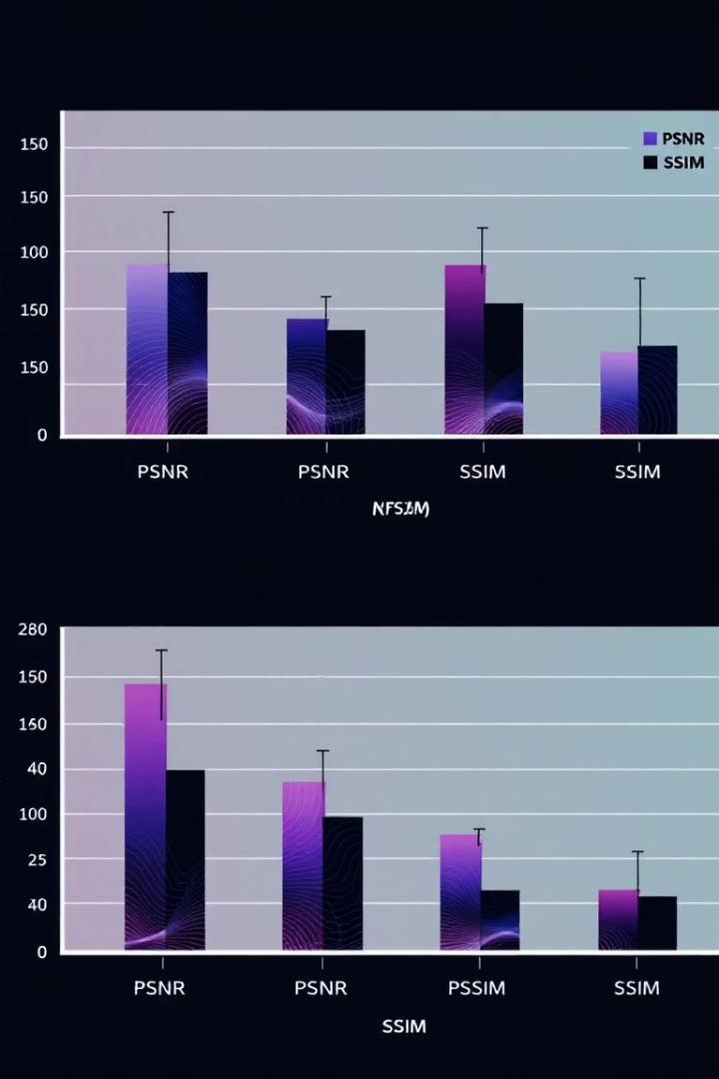
Quantitative Metrics
PSNR
Measures reconstruction accuracy; higher is better.
SSIM
Assesses perceptual similarity between original and processed images.
Comparison
Metrics help evaluate and choose the best enhancement technique.
Usage
Supports objective assessment alongside visual inspection.

Slide 9
Visualizations and Results
Image Comparison
Histograms
Heatmaps
Assessment
Original and enhanced images shown side-by-side.
Display pixel intensity distribution before and after equalization.
Visualize local contrast changes and enhancements.
Qualitative visual improvements support the quantitative metrics.

Slide 10
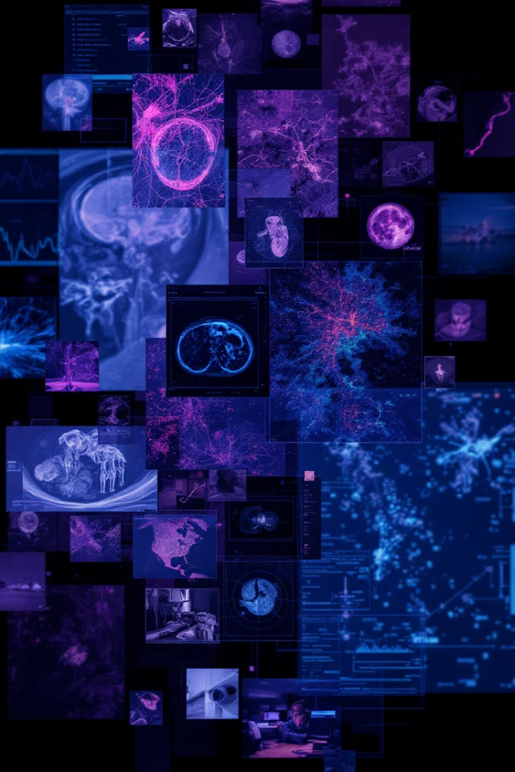



Real-World Applications and Conclusion
Medical Imaging
Satellite Imagery
Surveillance
Enhances X-rays, CT scans, and MRIs for better diagnosis.
Improves image clarity for environmental and geographic analysis.
Boosts visibility in low-light security footage.
Advanced enhancement techniques significantly improve image quality and utility. They enable more accurate analysis across many fields.

